Slide 1
Chapter 6
Open Methods

Slide 2
the open methods described in this chapter are based on formulas that require only a single starting value of x or two starting values that do not necessarily bracket the root.
they sometimes diverge or move away from the true root as the computation progresses
when the open methods converge, they usually do so much more quickly than the bracketing methods.

Slide 3
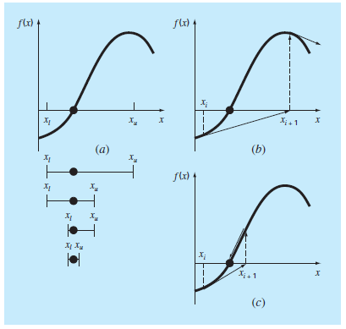
Graphical depiction of the fundamental difference between the (a) bracketing and (b) and (c) open methods for root location. In (a), which is the bisection method, the root is constrained within the interval prescribed by xl and xu. In contrast, for the open method depicted in (b) and (c), a formula is used to project from xi to xi11 in an iterative fashion. Thus, the method can either (b) diverge or (c) converge rapidly, depending on the value of the initial guess.

Slide 4

SIMPLE FIXED-POINT ITERATION
x = g(x)
$x_{i+1}=g\left(x_{i}\right)$
$ε_{a}= \frac{x_{i+1}−x_{i}}{x_{i+1}}∗100\%$

Slide 5
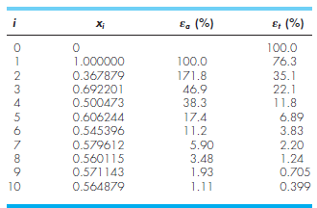

Use simple fi xed-point iteration to locate the root of $f\left(x\right)= e^{−x}−x$
$x_{i+1}=e^{−x_{i}}$

Slide 6
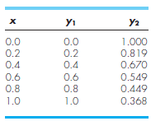
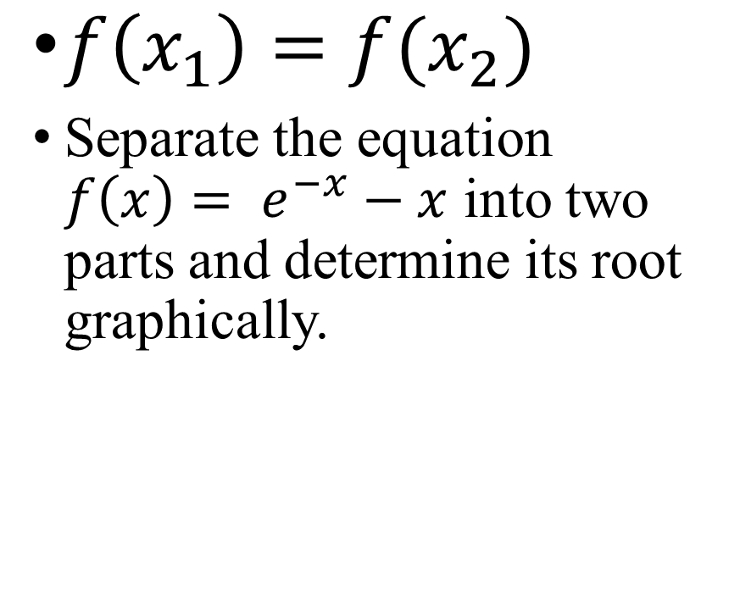
Convergence
$f\left(x_{1}\right)=f(x_{2})$
Separate the equation $f\left(x\right)= e^{−x}−x$ into two parts and determine its root graphically.

Slide 7
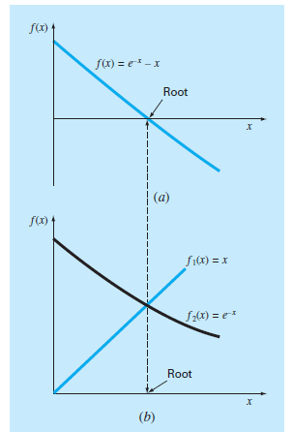
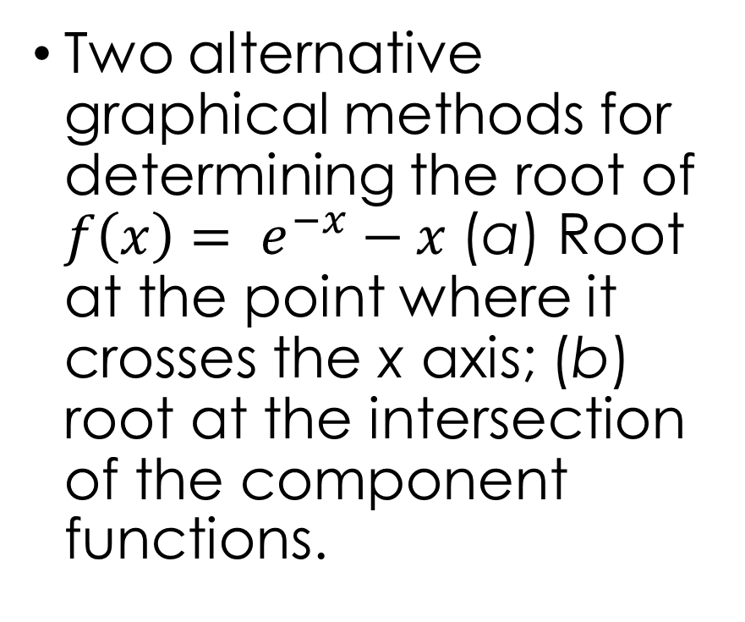
Two alternative graphical methods for determining the root of $f\left(x\right)= e^{−x}−x$ (a) Root at the point where it crosses the x axis; (b) root at the intersection of the component functions.

Slide 8
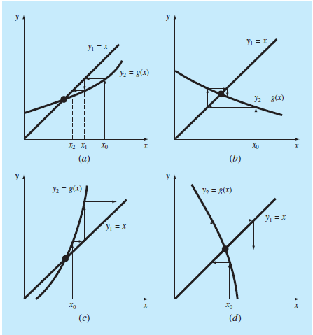
Iteration cobwebs depicting convergence (a and b) and divergence (c and d) of simple fixed-point iteration. Graphs (a) and (c) are called monotone patterns, whereas (b) and (d) are called oscillating or spiral patterns. Note that convergence occurs when |g’(x)| <1.

Slide 9
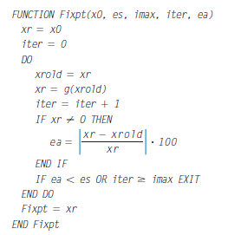
Algorithm

